Slide 1

M4 - Video Analysis
Video surveillance for road traffic monitoring.
Adrià Ciurana
Guim Perarnau
Pau Riba
Team 4
Notes:
[Adri]

Slide 2
Index
Introduction and motivation.
Methodology.
Background estimation.
Refinement step.
Stabilization.
Tracking.
Velocity estimator.
Results.
Conclusions.
Adrià Ciurana
Team 4
Notes:
[Adri]

Slide 3
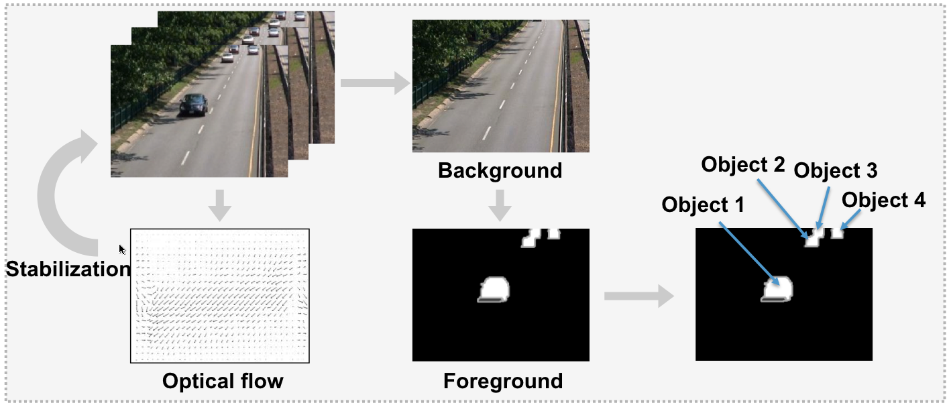
Introduction
Adrià Ciurana
Team 4
Notes:
[Adri]

Slide 4
Motivation
Visualization & analysis of results
Block 1
Video surveillance application
Foreground segmentation
Block 2 and 3
Stabilization
Block 4
Adrià Ciurana
Team 4
Notes:
[Adri] The motivation for this project is to apply all the contents we have learned during the whole module to make a complete system that could be used in the real world.
Most concretely, we apply:
How to visualize and analyze the details from block 1.
The foreground segmentation from block 2 and 3.
And the stabilization from block 4.

Slide 5
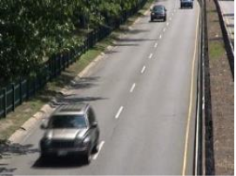
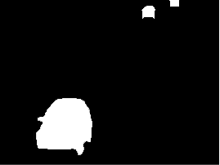
Methodology: Background estimation
Original image
Ground truth
RGB image
Binary image
Three approaches:
Non adaptive
Single Gaussian
Stauffer & Grimson
Adaptive
Pau Riba
Team 4
Notes:
[Pau] The first step consists of separating background and foreground. Like all of you, we have used three different methods that we’ll explain briefly because all of you have already implemented them. The first two are single gaussian method, which means one gaussian per pixel. The latter uses a mixture Gaussian Model.

Slide 6

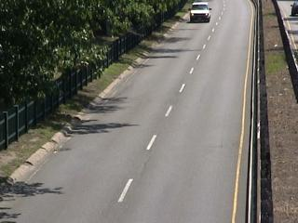
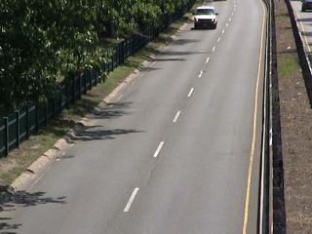
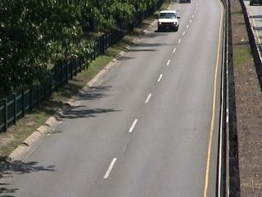

Methodology: Background estimation
Single Gaussian.
Segmentation
Training
Training set
For all pixel i, if
then foreground. Otherwise, background.
Adaptive
For all pixel i we obtain a Gaussian: ,
ρ: adaption speed
Pau Riba
Team 4
Notes:
[Pau] For the Single Gaussian, we need first to learn the parameters of each pixel Gaussian (mean and variance). Once we have them, we can segment each pixel individually between background and foreground. Alpha and sigma remain static for the non adaptive approach, but the adaptive version updates these parameters for each new frame. The adaptation speed is controlled with rho.

Slide 7
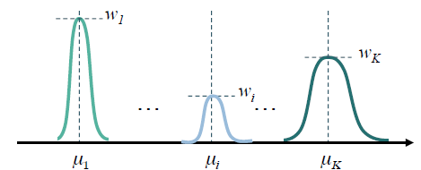
Methodology: Background estimation
Stauffer & Grimson.
Gaussian Mixture Model (GMM) → each Gaussian represents a foreground object or background segment
Each pixel is classified according to its nearest Gaussian.
Pau Riba
Team 4
Notes:
[Pau] As the single Gaussian method, S&G is based on the temporal observation of the pixels. Each pixel is assigned to its nearest Gaussian. If the Gaussian models foreground (background), the pixel will be detected as foreground (background). The authors claim that this technique reliably deals with lighting changes, repetitive motions from
clutter, and long-term scene changes.

Slide 8
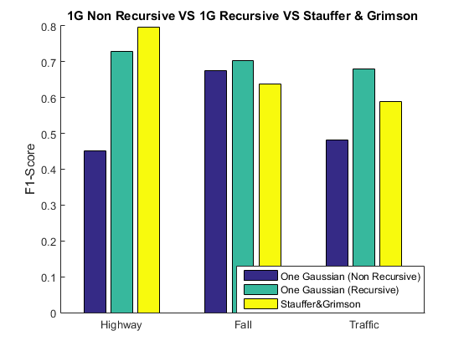
Methodology: Background estimation
Results.
Pau Riba
Team 4
Notes:
[Pau] After a parameter tuning process, these are the results that we get for three different datasets. One Gaussian adaptive is, in average, the best one. So we will use this technique for our system.

Slide 9
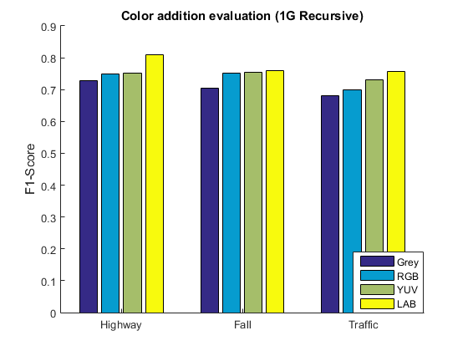
Methodology: Background estimation
Color addition.
The extra information given by the color improves the previous background estimation, being LAB color space the best among the ones tested.
Pau Riba
Team 4
Notes:
[Pau] Once the method have been chosen, different color spaces have been tested. RGB, YUV and LAB. Best performance for all the sequences were achieved with LAB color space. The extra information makes a significant improvement with respect gray-scale background estimation

Slide 10

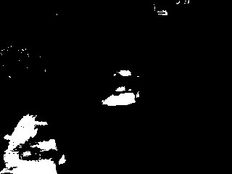

Methodology: Refinement step
Join blobs around the foreground objects
Fill holes inside objects
Remove noise and avoid next steps to generate more
Background estimation
Background Mask
BEFORE
AFTER
Area filtering
↓FP
Closing
Hole Filling
↓FN
Guim Perarnau
Team 4
Notes:
[Guim] The refinement module consist in two main blocks, taking the background mask, we can apply an area filtering to avoid false positives. Here we delete also the background noise. The next block tries to avoid false negatives. Now we perform a closing to join near blobs and finally a hole filling.

Slide 11
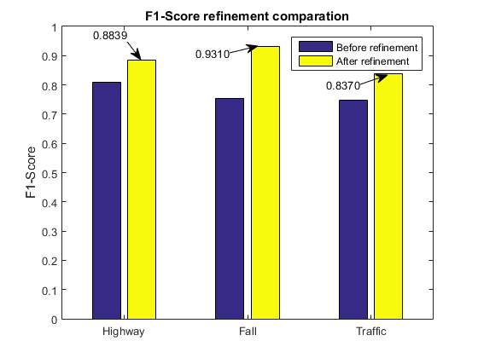
Methodology: Refinement step
Results.
(Higher AUC is better)
 | Background (AUC) | Refinement (AUC)
Highway | 0.7539 | 0.8423 (+11%)
Fall | 0.7954 | 0.9526 (+19%)
Traffic | 0.7081 | 0.7807 (+10%)
Average | 0.7525 | 0.8585 (+14%)
Guim Perarnau
Team 4
Notes:
[Guim]

Slide 12


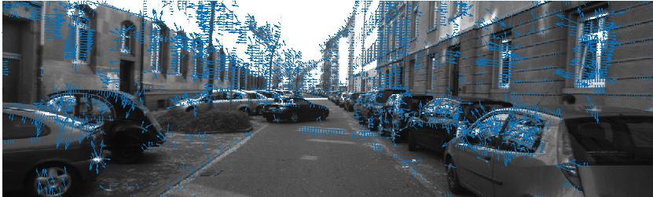

Methodology: Optical flow for stabilization
Obtain Optical Flow
Block Matching
Obtain the mode of the vectors.
Calculate transformation matrix
Stabilize video
Lucas-Kanade
Stabilization does not improve the performance of the model, so we don’t use it.
Guim Perarnau
Team 4
Notes:
[Guim]

Slide 13
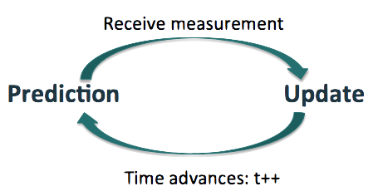
Methodology: Vehicle tracker
Tracking.
Kalman filter
Wang 2013 [1]
Optimal method for tracking linear dynamical models.
Assumption: Gaussian noise.
Object to track
Denoising autoencoder
Features
Neural network
Prediction
[1] Yi Wang, Pierre-Marc Jodoin, et al., “Cdnet 2014: An expanded change detection benchmark dataset,” in CVPRW, 2014, pp. 393–400.
Guim Perarnau
Team 4
Notes:
[Guim]
How do we create a tracker? How do we know if a foreground pixel should we tracked? This is what Adria will now explain you

Slide 14
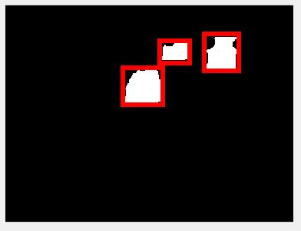


Methodology: Vehicle tracker
Measurement assignment.
Measurement:
State:
New measurement
It is near to vehicle tracker?
no
New vehicle tracker
Centroid, width and height.
yes
Measurement assigned to this vehicle (update)
Adrià Ciurana
Team 4
Notes:
[ADRI]

Slide 15
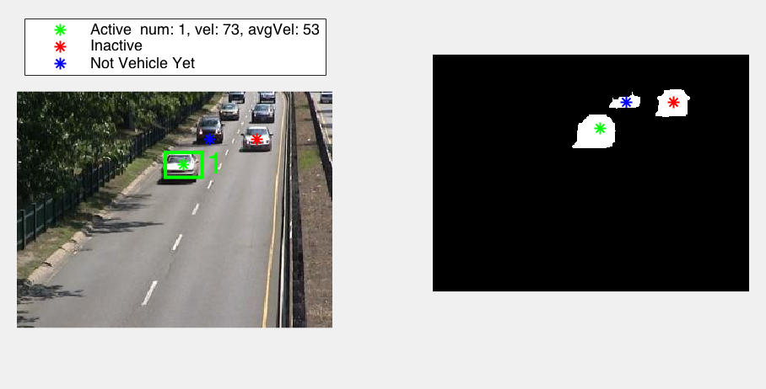
Methodology: Vehicle tracker
Vehicle status.
New vehicle tracker
Not vehicle yet
Inactive
Active
Delete Tracker
Adrià Ciurana
Team 4
Notes:
[ADRI]

Slide 16
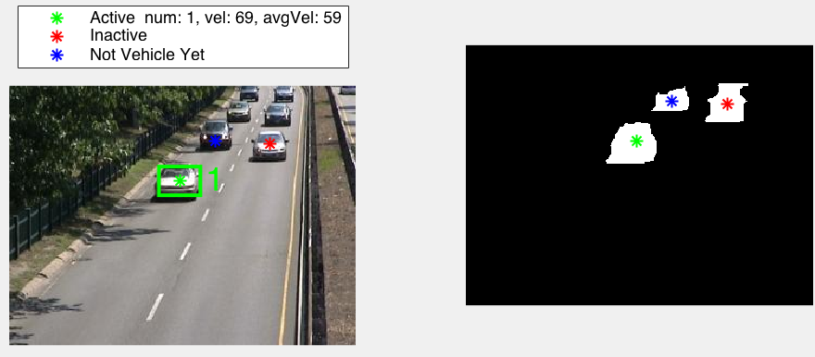
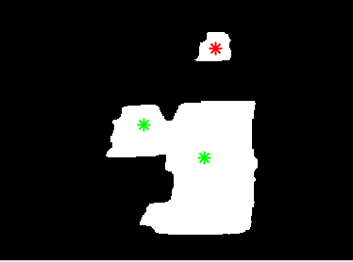
Methodology: Vehicle tracker
Life system.
New vehicle tracker: constant life.
New measurement: ↑ life.
For each frame: ↓ life.
Near trackers: ↓ life with less time activated.
Delete tracker when:
No life left.
Tracker leaves the image.
Update tracker
Merge penalization
Adrià Ciurana
Team 4
Notes:
[ADRI]

Slide 17

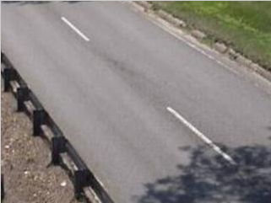
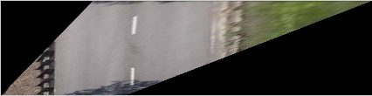

Methodology: Vehicle tracker
Homography.
Vanish point
Parallel lines
Pau Riba
Team 4
Notes:
[Pau]

Slide 18
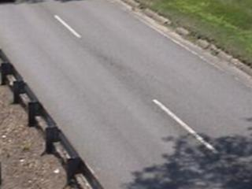
Methodology: Vehicle tracker
From pixels to kilometers.
User inputs a real measure.
3 meters
3 meters = p pixels
U.S. Federal Transportation Guide
Pau Riba
Team 4
Notes:
[Pau] Mention that we have looked in the U.S Federal Transportation Guide to know the length of this road line.

Slide 19
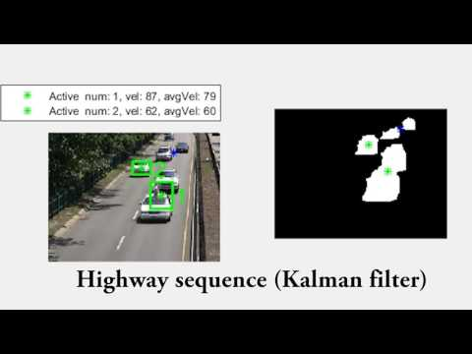
Video
 | Car 1 | Car 2 | Car 3 | Car 4
Highway | 62.00 km/h | 88.19 km/h | 54.28 km/h | 53.86 km/h
Traffic | 69.50 km/h | 68.42 km/h | 57.36 km/h | 61.68 km/h
Guim Perarnau
Team 4
Notes:
[Guim]

Slide 20

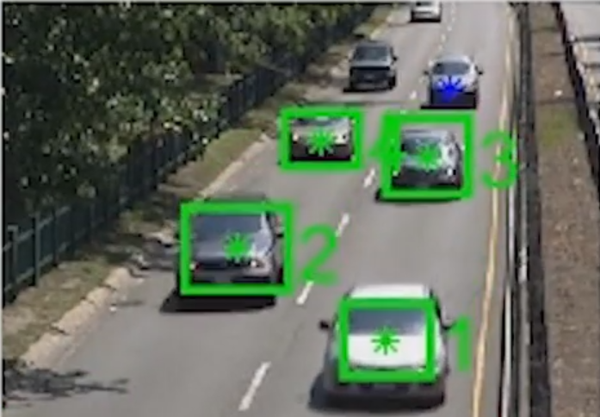



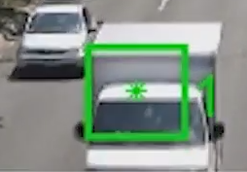
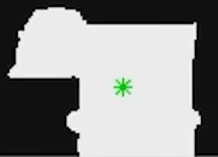
Results
Estimated speed is approx. constant.
Works well with multiple cars.
Fails when there are shadows.
Fails when there are occlusions.
Fails for noisy segmentations.
Guim Perarnau
Team 4
Notes:
[Guim]

Slide 21
Conclusions
Whole system for traffic monitoring.
Good speed estimation and car tracker.
Stabilization decreases the obtained results.
Shadow detector cannot help in this kind of videos.
Guim Perarnau
Team 4
Notes:
[Guim]

Slide 22


Slide 23
Team 4

Slide 24
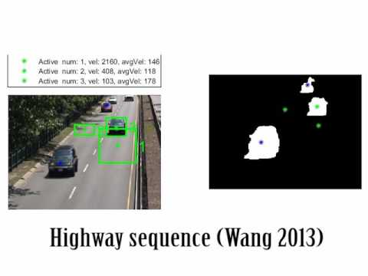
Estimation with Wang 2013 is unstable due to bounding boxing constantly changing size and aspect ratio.
Team 4
Notes:
SDA+NN (Wang2013) is very good at tracking the objects, but as the bounding boxes constantly change the size and aspect ratio, the velocity estimation is more unstable (in one frame we have 55 kmh and in the next one 220 kmh, for example). Also, the problem of Wang method is that it is up to us to give the original bounding box of the object to track, which Ondepends on the segmentation that can be noisy.

